Slide 1
Imdb top 2000 movies
CAPSTONE PROJECT
Presented By:
Kartheesan . P
9513- Jayaraj Annapackiam CSI College Of Engineering
B.E Mechanical Engineering

Slide 2
OUTLINE
Problem Statement
Proposed System/Solution
System Development Approach
Algorithm & Deployment
Result
Conclusion
Future Scope
References

Slide 3
Problem Statement
Creating an IMDb Top 2000 movies list would involve several steps:
Data Collection: Gather information about movies from IMDb or a similar database. This includes the movie title, release year, genre, director, and ratings.
Filtering: Narrow down the list to the top-rated movies based on user ratings or critic scores. IMDb has a rating system that could be used for this purpose.
Ranking: Sort the filtered list based on ratings to create a ranked list from highest to lowest rated.
Display: Present the ranked list in a user-friendly format, possibly with additional details like movie posters, brief descriptions, and links to IMDb pages for more information.
Update: Regularly update the list to reflect changes in ratings or the addition of new movies to IMDb's database.

Slide 4
Proposed Solution
Data Collection:
Use IMDb's official API or web scraping techniques to gather information about movies. The API is preferable as it provides structured data and is more reliable.
Collect data such as movie title, release year, genre, director, IMDb rating, number of votes, and any other relevant information.
Filtering and Sorting:
Filter the collected data to include only movies with a significant number of votes (e.g., above a certain threshold like 10,000 votes) to ensure reliability.
Sort the filtered data based on IMDb ratings in descending order to rank the movies from highest to lowest rated.
Analysis:
Generate statistical insights from the top 2000 movies list. This could include:
Average rating of the top 2000 movies.
Distribution of movies by genre, director, release year, etc., within the top 2000 list.
Top-rated movies by decade (e.g., top-rated movies from the 2000s, 2010s, etc.).
Relationship between ratings, number of votes, and box office performance (if box office data is available).
Visualization:
Create visualizations such as bar charts, pie charts, and histograms to present the analysis findings in a visually appealing and understandable manner.
Use tools like Matplotlib, Seaborn, or Plotly for data visualization.

Slide 5
System Approach
Data Acquisition:
Utilize IMDb's official API to fetch movie data programmatically. This API provides structured access to IMDb's vast database, including movie titles, ratings, release years, genres, directors, and more.
Alternatively, if IMDb's API is not accessible, consider using web scraping techniques to extract movie data from IMDb's website. Be mindful of legal and ethical considerations while scraping..
Analysis and Insights:
Conduct statistical analysis to derive insights from the IMDb Top 2000 movies list. This may involve calculating average ratings, analyzing genre distributions, exploring trends over decades, or identifying top-rated directors.
Generate visualizations (e.g., bar charts, pie charts, heatmaps) to present the analysis findings effectively. Use libraries like Matplotlib, Seaborn, or Plotly for visualization.
User Interface:
Develop a user-friendly interface where users can interact with the IMDb Top 2000 movies list. This could be a web application, desktop application, or mobile app.
Include features such as search functionality, filters by genre or year, and detailed movie information (e.g., synopsis, cast, trailers).
Automation and Updates:
Implement automation to periodically update the IMDb Top 2000 movies list and analysis. Schedule data refreshes at regular intervals (e.g., weekly, monthly) to reflect changes in ratings and new movie additions.
Notify users or administrators about updates and changes to keep the system up-to-date..
Quality Assurance:
Conduct thorough testing to validate the system's functionality, data accuracy, and user experience. Perform unit testing, integration testing, and user acceptance testing.
Address any bugs, errors, or usability issues identified during testing to deliver a reliable and seamless user experience.

Slide 6
Algorithm & Deployment
Algorithm for IMDb Top 2000 Movies List
Data Collection and Preprocessing:
Use IMDb's API or web scraping techniques to gather movie data.
Clean the data by removing duplicates, handling missing values, and standardizing formats.
Filtering and Ranking:
Filter the data to include movies with a significant number of votes (e.g., >10,000).
Rank the filtered data based on IMDb ratings in descending order.
Statistical Analysis:
Calculate average ratings, genre distributions, top-rated directors, and other relevant statistics.
Generate visualizations (e.g., bar charts, pie charts) for insights presentation.
Algorithm Steps:
Initialize the data collection process.
Clean and preprocess the collected data.
Filter and rank the movies based on specified criteria.
Conduct statistical analysis and generate visualizations.

Slide 7
Deployment
Web Application:
Develop a web-based platform for users to access the IMDb Top 2000 movies analysis.
Use frameworks like Flask (Python), Django (Python), or Node.js (JavaScript) for backend development.
Implement HTML, CSS, and JavaScript for frontend design and interactivity.
Database Integration:
Store the preprocessed movie data in a database (e.g., PostgreSQL, MySQL) for efficient retrieval and management.
Ensure database security and backup procedures are in place.
API Integration:
If the analysis is to be accessed programmatically, develop an API using tools like FastAPI (Python), Express.js (JavaScript), or Flask-RESTful (Python).
Define endpoints for data retrieval, analysis execution, and result presentation.
Deployment Options:
Deploy the web application and API to a cloud platform like AWS (Amazon Web Services), Azure, or Google Cloud Platform.
Utilize platform-as-a-service (PaaS) offerings such as AWS Elastic Beanstalk, Azure App Service, or Google App Engine for streamlined deployment and scalability.
Security Considerations:
Implement authentication and authorization mechanisms to secure user access to the analysis platform.
Apply HTTPS encryption for data transmission.
Regularly audit and update security measures to protect against vulnerabilities.

Slide 8
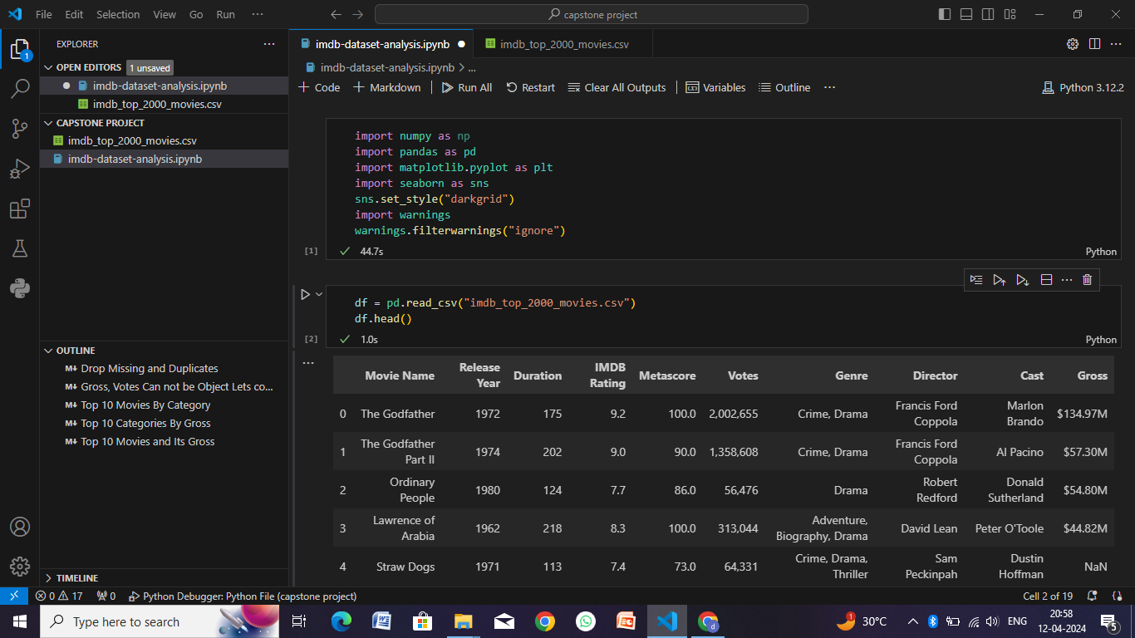
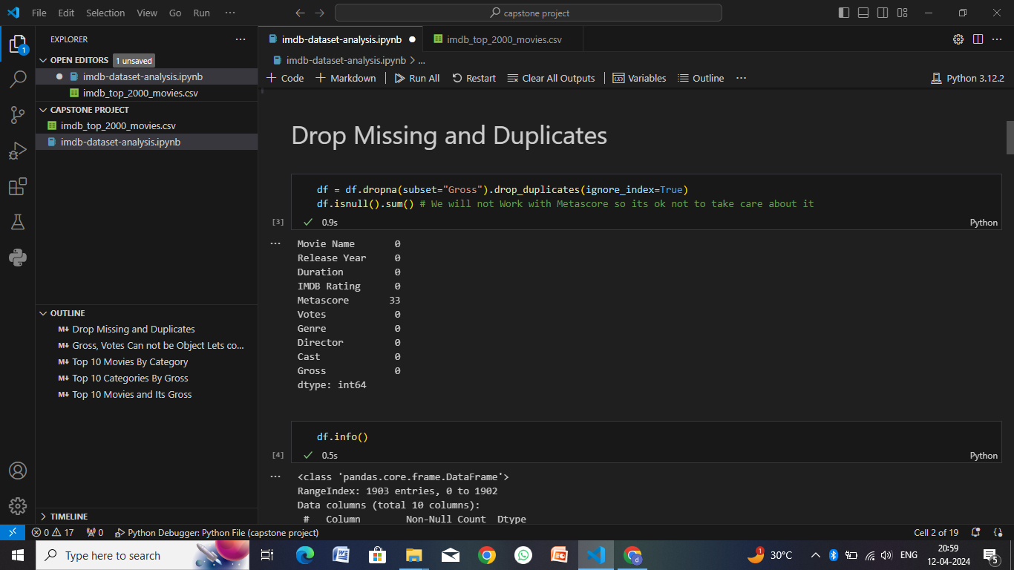
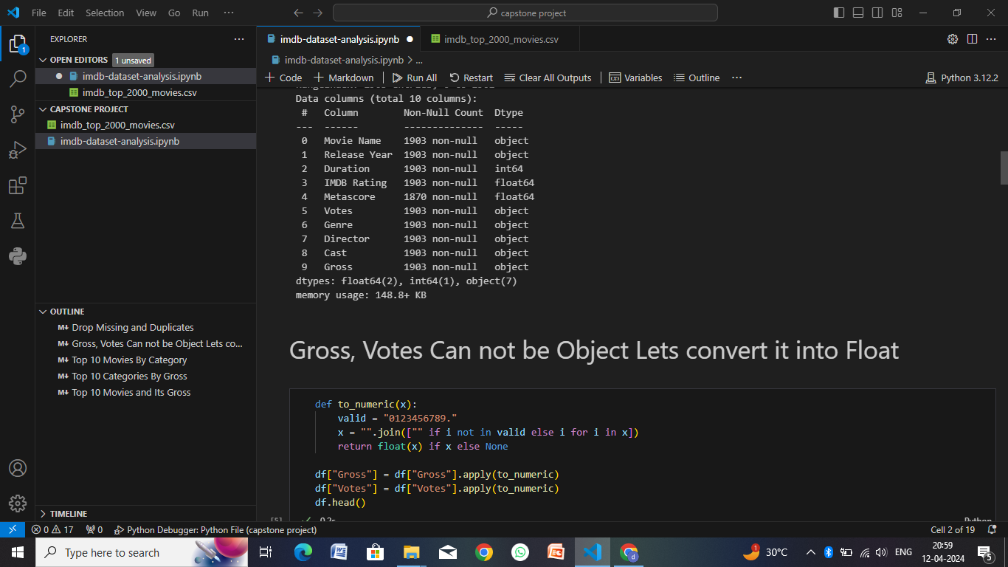
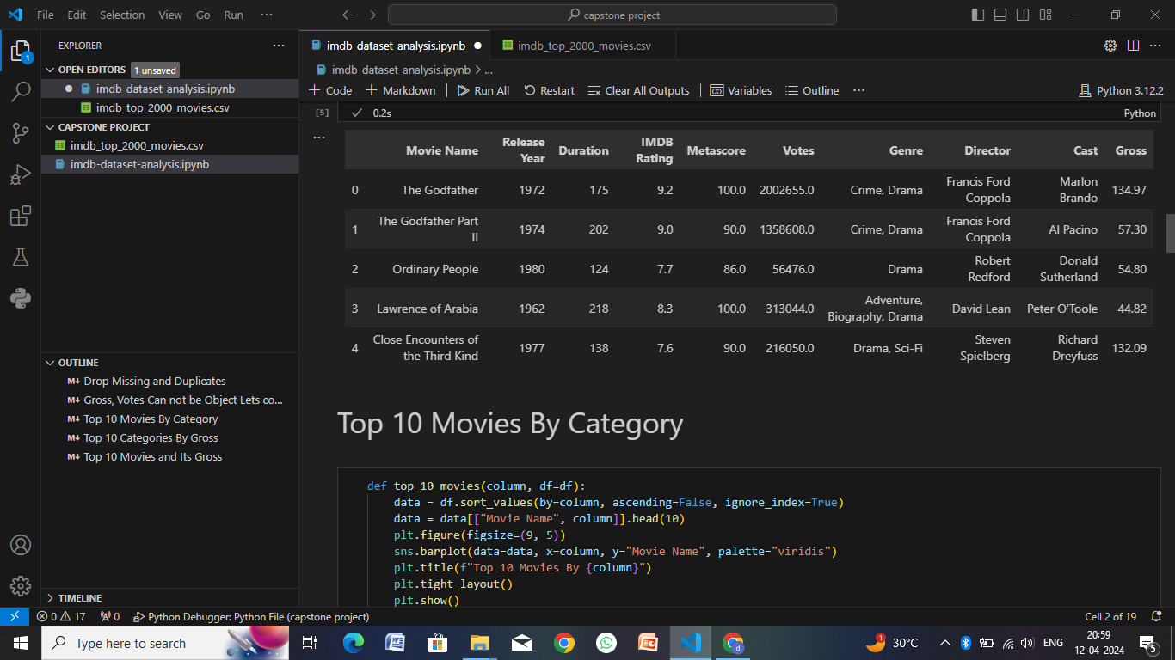
Result

Slide 9
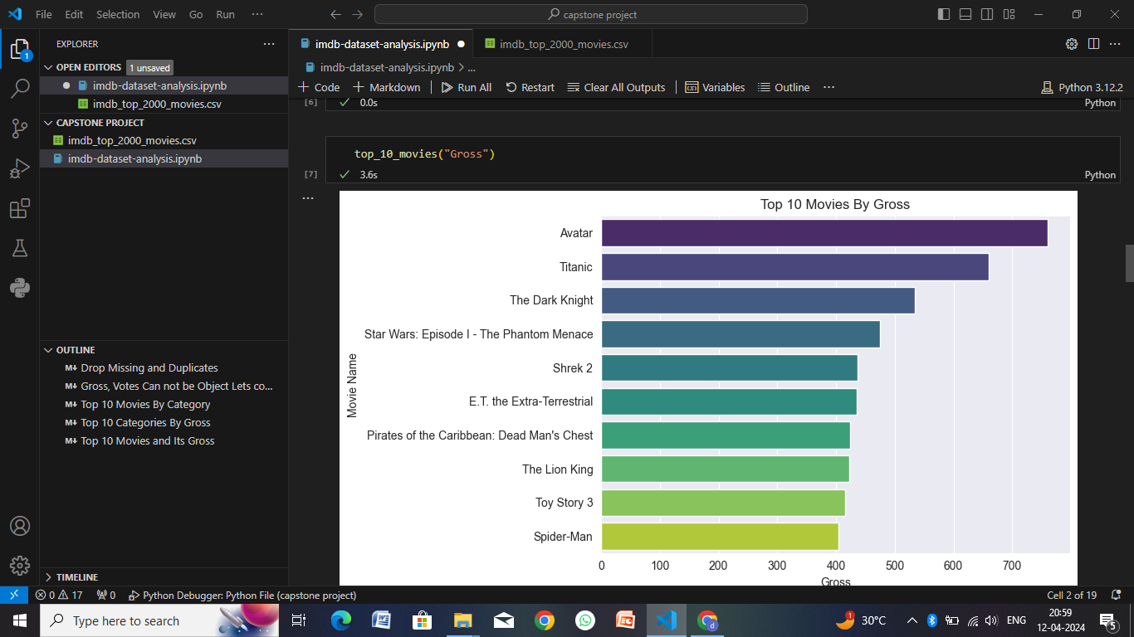
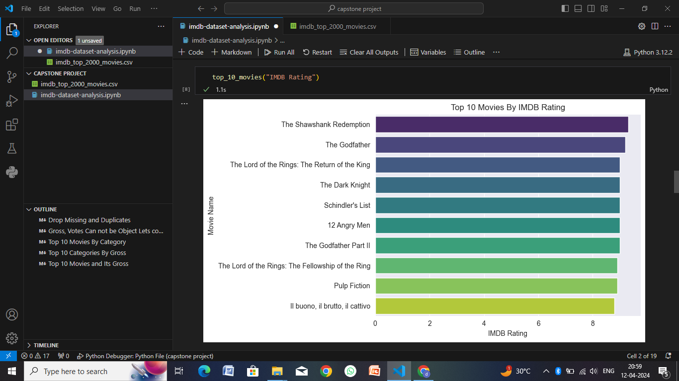
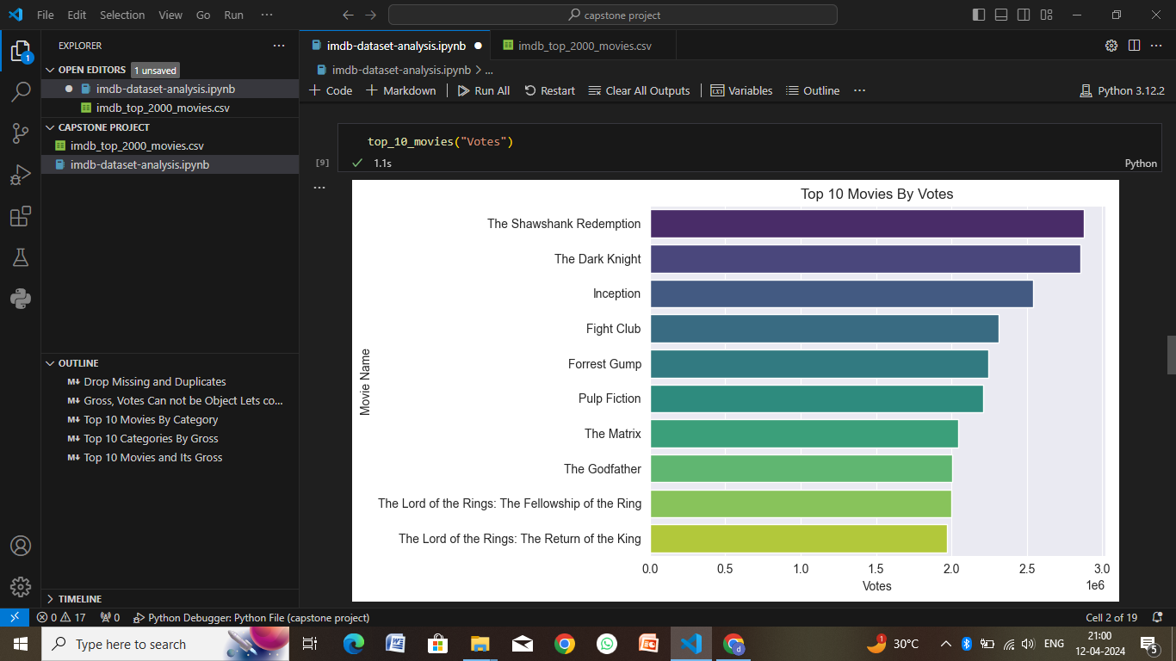
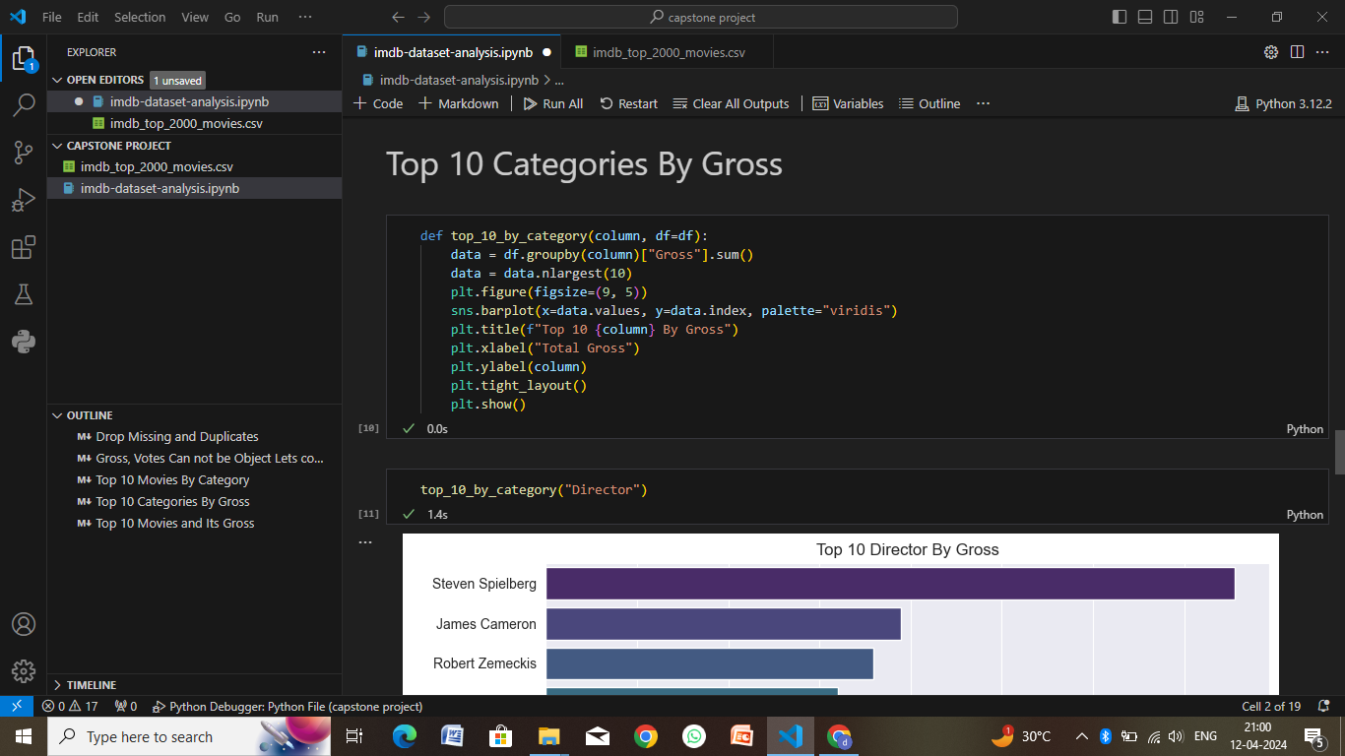

Slide 10
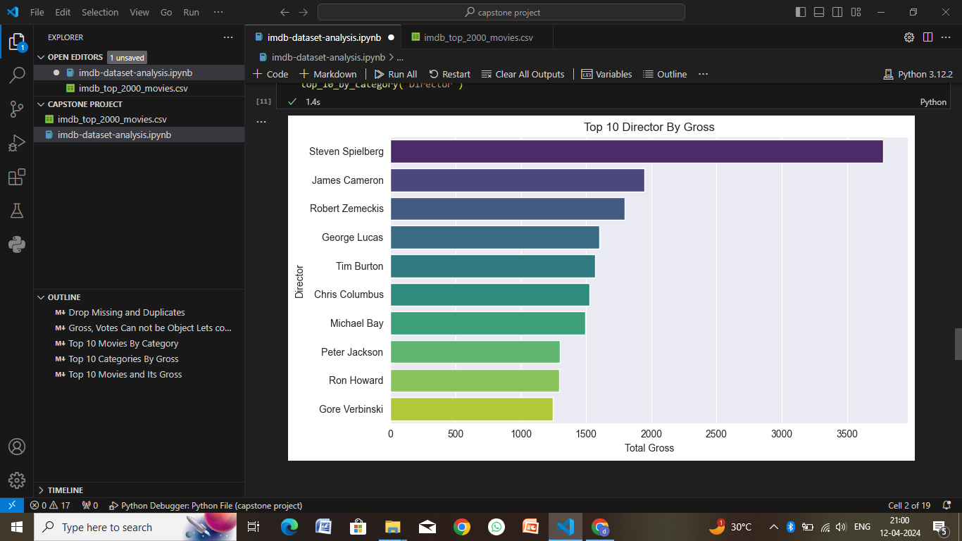
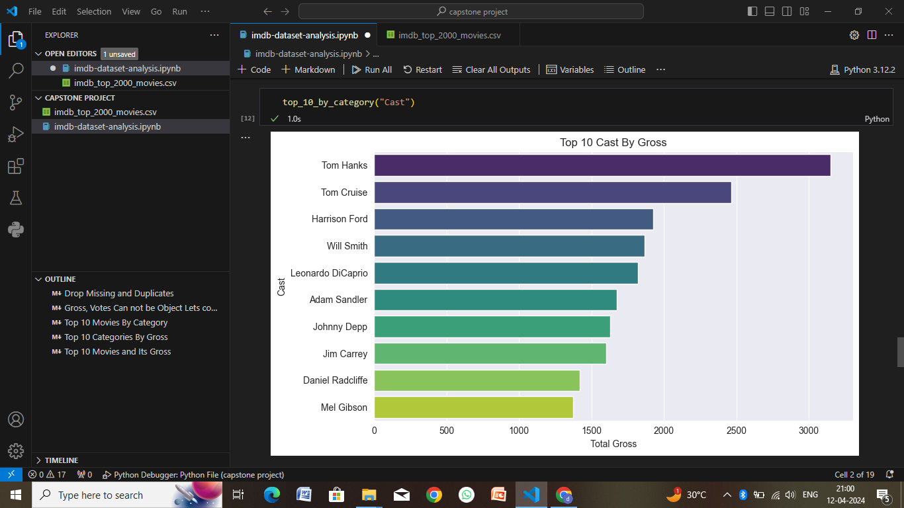
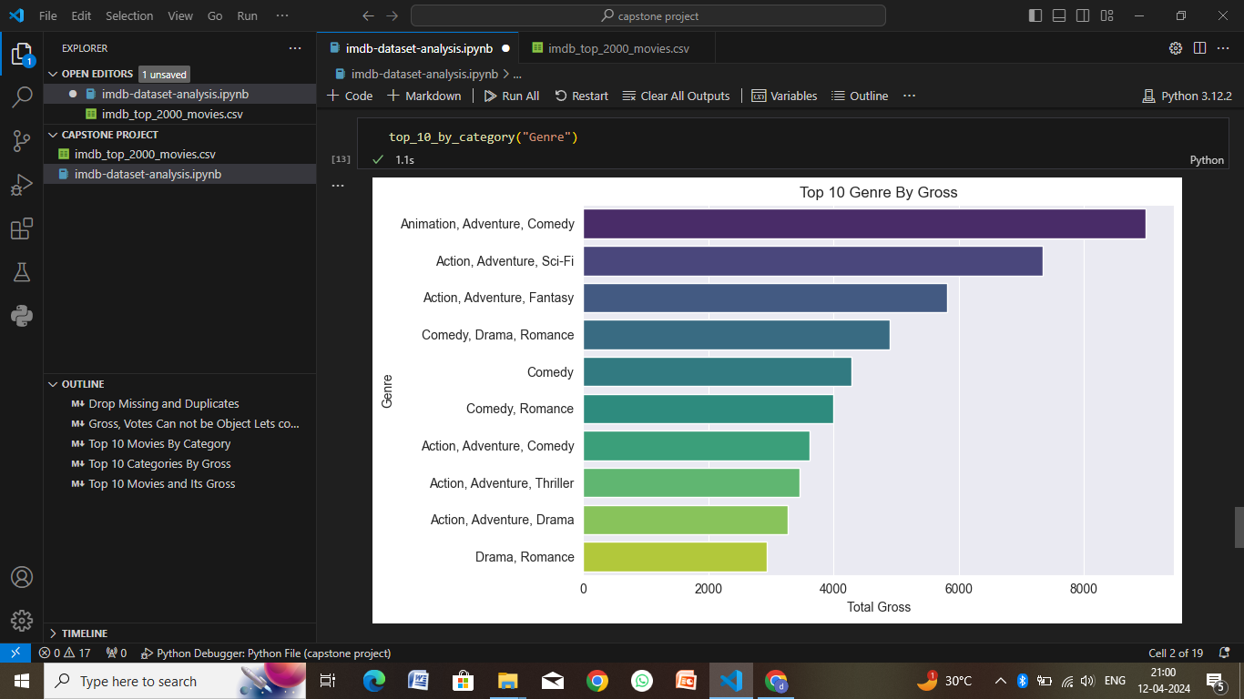
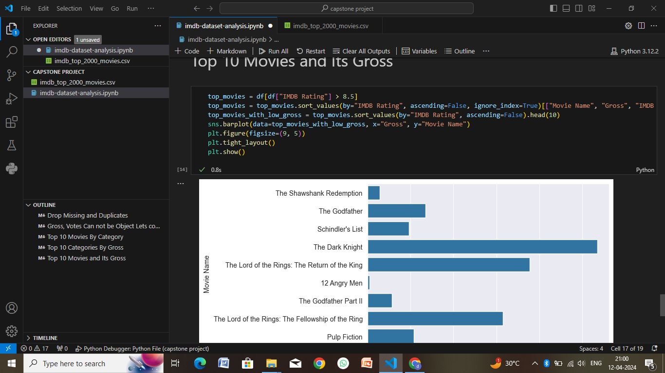

Slide 11
Conclusion
The conclusion of an IMDb Top 2000 movies analysis would typically summarize the key findings, insights, and implications drawn from the data. Here's how you might structure the conclusion. Summarize the main takeaways from the IMDb Top 2000 movies analysis, emphasizing the insights gained and the value of the analysis.Conclude with a final thought or reflection on the significance of IMDb ratings in evaluating movie quality and audience preferences:
Overview of the Analysis
Key Findings
Statistical Insights
Genre Analysis
Director and Country Analysis
User Engagement and Popularity
Limitations and Considerations
Implications and Recommendations

Slide 12
Future scope
The future scope of an IMDb Top 2000 movies analysis can be quite expansive and can lead to several potential avenues for further exploration and development. Here are some areas to consider for future scope:
Dynamic Updating
User Personalization
Advanced Analytics
Comparative Analysis
Interactive Visualizations
Cross-Platform Integration
Social Features
Mobile Optimization
Ethical Considerations
Collaborative Research

Slide 13
References
When referencing an IMDb Top 2000 movies analysis, it's important to cite the sources and methodologies used in the analysis. Here's an example of how you might structure a reference for such an analysis:
Reference:
Title: IMDb Top 2000 Movies Analysis: A Comprehensive Study of Ratings and Trends Author(s): [Your Name or Research Team] Publication Year: [Year of Analysis] Website or Platform: IMDb (www.imdb.com) Accessed Date: [Date Accessed]

Slide 14
THANK YOU

